Slide 1
Simulation Technique
Example of Queueing Model

Slide 2
Objectives
Understand the concept of simulation
Understand the concept of discrete event simulation

Slide 3
The Airport System …
A certain airport contains a single runway on which arriving aircrafts must land.
Once an aircraft is cleared to land, it will use the runway, during which time no other aircraft can be cleared to land.
Once the aircraft has landed, the runway is available for use by other aircraft. The landed aircraft remains on the ground for a certain period of time before departing.

Slide 4
Model Development Life Cycle
Define goals, objectives of study
Develop conceptual model
Fundamentally an iterative process
Develop specification of model
Develop computational model
Verify model
Validate model

Slide 5
Conceptual Model: Single Server Queue
queue
customer
server
Customer (aircraft)
  Entities utilizing the system/resources
Server (runway)
  Resource that is serially reused; serves one customer at a time
Queue
  Buffer holding aircraft waiting to land

Slide 6
Objectives
Objective: Evaluate the performance of the Airport System
Performance Metrics
  Average waiting time: Average time that an aircraft must wait when arriving at an airport before they are allowed to land.
  Maximum number of aircraft on the ground: Helps to dimension the required surface for the parking area.

Slide 7
Conceptual Model: Single Server Queue
queue
customer
server
Customer (aircraft)
  Entities utilizing the system/resources
Server (runway)
  Resource that is serially reused; serves one customer at a time
Queue
  Buffer holding aircraft waiting to land

Slide 8
Specification Model (Queueing Networks)
Customers
  What is the arrival process?
    Schedule of aircraft arrivals, e.g., log from specific dates (trace driven)
    Often, probability distribution defines time between successive customer arrivals (interarrival time)
      Assumes interarrival times independent, and identically distributed (iid)
      Not always true (e.g., customers may leave if lines are too long!)
  Customer attributes?
    Sometime different flavors, e.g., priorities or other properties
Servers
  How much service time is needed for each customer?
    May use probability distribution to specify customer service time (iid)
  How many servers?
Queue
  Service discipline - who gets service next?
    First-in-first-out (FIFO), Last-in-first-out (LIFO), random …
    May depend on a property of the customer (e.g., priority, “smallest” first)
    Preemption?
  Queue capacity? What if the queue overflows?

Slide 9
Specification Model (cont.)
Assumptions
Customers
  Poisson Arrival Process: Assume arrivals are i.i.d., following an exponential distribution for inter-arrival times with mean A
  Assume all customers are identical (no specific attributes)
Servers
  Exponential service time (landing time) with mean L
  One server (one runway)
Queue
  Assume first-in-first-out queue (FIFO) discipline
  Assume queue has unlimited capacity

Slide 10
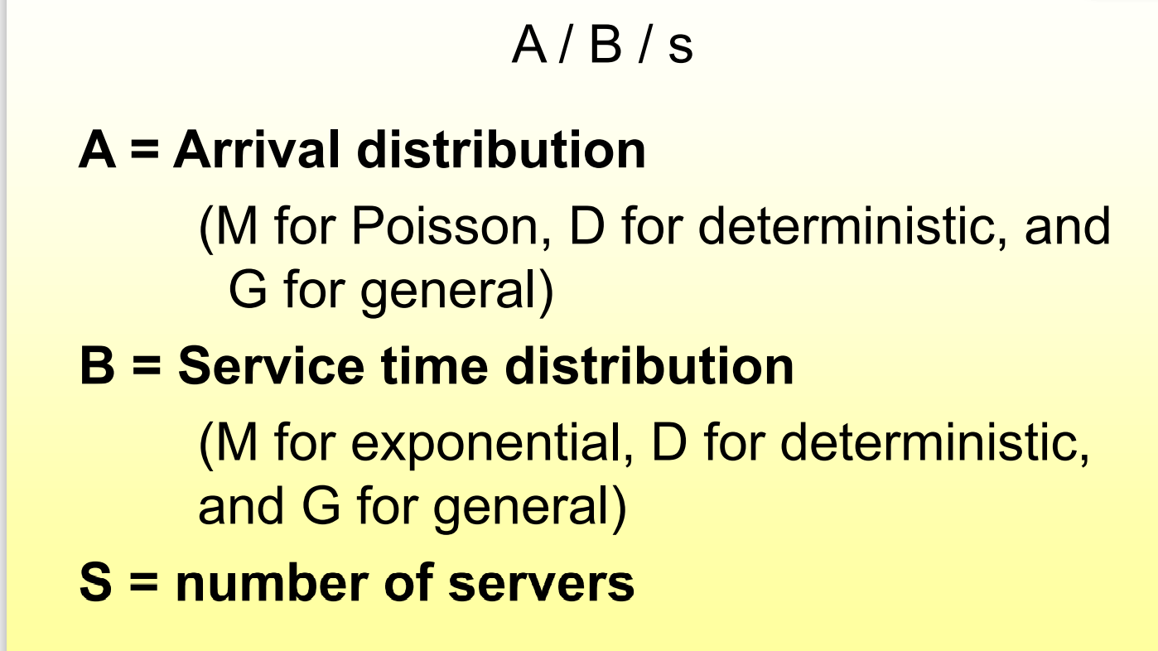

Slide 11
Computational Model
The System correspond to M/M/1 Queue Model.
Performance evaluation
  Analytical: using queuing theory
  Simulation: using a computer program
A computer simulation is a computer program that emulate the behavior of a physical system over time.
How a computer simulation works?
  Define state variables: variables that represent a state of the system (e.g. N: number of customers in the queue)
  Define events: a event changes a state variable of the system (e.g. Arrival, Departure).

Slide 12
Computational Model
The General Algorithm of a simulation program
  Define state variables
  Define the events
  For each Event do
    Change the corresponding state variables
    Create next events, if any
    Collect statistics
    Progress simulation time
Simulation time can progress by two means:
  Regular progress: Time Step implementation
  Irregular progress: Event-based implementation

Slide 13
State Variables
queue
customer
server
State:
InTheAir: number of aircraft either landing or waiting to land
OnTheGround: number of landed aircraft
RunwayFree: Boolean, true if runway available

Slide 14
Time Step Implementation
Advantage
  Simple
Drawback
  Not efficient
/* ignore aircraft departures */
Float InTheAir: # aircraft landing or waiting to land
Float OnTheGround: # landed aircraft
Boolean RunwayFree: True if runway available
Float NextArrivalTime: Time the next aircraft arrives
Float NextLanding: Time next aircraft lands (if one is landing)
For (Now = 1 to EndTime) { /* time step size is 1.0 */
if (Now >= NextArrivalTime) { /* if aircraft just arrived */
InTheAir := InTheAir + 1;
NextArrivalTime := NextArrivalTime + RandExp(A);
if (RunwayFree) {
RunwayFree := False;
NextLanding := Now + RandExp(L);
}
}
if (Now >= NextLanding) { /* if aircraft just landed */
InTheAir := InTheAir - 1;
OnTheGround := OnTheGround + 1;
if (InTheAir > 0) NextLanding := Now + RandExp(L)
else {RunWayFree := True; NextLanding := EndTime+1;}
}
}

Slide 15
Discrete Event Simulation
Discrete Event Simulation (DES): computer model for a system where changes in the state of the system occur at discrete points in simulation time.
Each Event has a timestamp indicating when it occurs.
  A DES computation: a sequence of events, where each event is assigned a timestamp, which to help to order/schedule the processing of events.

Slide 16
Discrete Event Simulation Computation
Example: air traffic at an airport
Events: aircraft arrival, landing, departure
arrival
8:00
schedules
departure
9:15
arrival
9:30
processed event
current event
unprocessed event
landed
8:05
schedules
simulation time
Events that have been scheduled, but have not been simulated (processed) yet are stored in a pending event list
Events are processed in time stamp order; why?

Slide 17
Discrete Event Simulation System
Model of the physical system
Simulation Application
state variables
code modeling system behavior
I/O and user interface software
calls to
schedule
events
calls to event
handlers
Independent of the simulation application
Simulation Engine
event list management
managing advances in simulation time

Slide 18
Events
An event must be associated with any change in the state of the system
Airport example:
  Event 1: Aircraft Arrival
  (InTheAir, RunwayFree)
  Event 2: Aircraft Landing
  (InTheAir, OnTheGround, RunwayFree)
  Event 3: Aircraft Departure
  (OnTheGround)

Slide 19
Event-Oriented World View
  Event handler procedures
state variables
Arrival Event
{
…
}
Landed Event
{
…
}
Departure Event
{
…
}
Integer: InTheAir;
Integer: OnTheGround;
Boolean: RunwayFree;
Simulation Application
Simulation Engine
  Event processing loop
Now = 8:45
While (simulation not finished)
E = smallest time stamp event in PEL
Remove E from PEL
Now := time stamp of E
call event handler procedure
Pending Event List (PEL)
9:00
10:10
9:16

Slide 20
Example: Air traffic at an Airport
Model aircraft arrivals and departures, arrival queuing
Single runway for incoming aircraft, ignore departure queuing
  L = mean time runway used for each landing aircraft (exponential distrib.)
  G = mean time on the ground before departing (exponential distribution)
  A = mean inter-arrival time of incoming aircraft (exponential distribution)
States
  Now: current simulation time
  InTheAir: number of aircraft landing or waiting to land
  OnTheGround: number of landed aircraft
  RunwayFree: Boolean, true if runway available
Events
  Arrival: denotes aircraft arriving in air space of airport
  Landed: denotes aircraft landing
  Departure: denotes aircraft leaving

Slide 21
Arrival Events
Arrival Process: New aircraft arrives at airport.
  If the runway is free, it will begin to land.
  Otherwise, the aircraft must circle, and wait to land.
A: mean interarrival time of incoming aircraft
Now: current simulation time
InTheAir: number of aircraft landing or waiting to land
OnTheGround: number of landed aircraft
RunwayFree: Boolean, true if runway available
Arrival Event:
InTheAir := InTheAir+1;
Schedule Arrival event @ Now + RandExp(A);
If (RunwayFree) {
RunwayFree:=FALSE;
Schedule Landed event @ Now + RandExp(L);
}

Slide 22
Landed Event
Landing Process: An aircraft has completed its landing.
L = mean time runway is used for each landing aircraft
G = mean time required on the ground before departing
Now: current simulation time
InTheAir: number of aircraft landing or waiting to land
OnTheGround: number of landed aircraft
RunwayFree: Boolean, true if runway available
Landed Event:
InTheAir:=InTheAir-1;
OnTheGround:=OnTheGround+1;
Schedule Departure event @ Now + RandExp(G);
If (InTheAir>0)
Schedule Landed event @ Now + RandExp(L);
Else
RunwayFree := TRUE;

Slide 23
Departure Event
Departure Process: An aircraft now on the ground departs for a new destination.
Now: current simulation time
InTheAir: number of aircraft landing or waiting to land
OnTheGround: number of landed aircraft
RunwayFree: Boolean, true if runway available
Departure Event:
OnTheGround := OnTheGround - 1;

Slide 24
Execution Example
State Variables
L=3 G=4
InTheAir
0
1
2
1
0
OnTheGround
0
1
2
1
0
RunwayFree
true
false
true
0
1
2
3
4
5
6
7
8
9
10
11
Simulation Time
Processing:
Arrival F1
Arrival F2
Landed F1
Landed F2
Depart F1
Depart F2
Time
Event
Time
Event
Time
Event
Time
Event
Time
Event
Time
Event
Time
Event
1 Arrival F1
3 Arrival F2
3 Arrival F2
4 Landed F1
4 Landed F1
7 Landed F2
8 Depart F1
8 Depart F1
11 Depart F2
11 Depart F2
Now=0
Now=1
Now=3
Now=4
Now=7
Now=8
Now=11

Slide 25
Output Statistics
Compute
The maximum number of aircraft that will be on the ground at one time
Average time an aircraft must wait before they are allowed to land
Solution
Maximum on ground
  OnTheGround: indicate the number of aircraft currently on ground
  Maximum “on the ground” = Max (OnTheGround).
Average Waiting time
  Compute the Waiting time for each aircraft: Wi = Arrival time – Landing Time
  Compute the total sum of all waiting times: W_{total}= sum(W_{i})
  Compute the total number of aircraft: N_{total}
  Compute the average waiting time: W_{avg} = W_{total}/sum(W_{i})

Slide 26
Summary
Methodology
  Important to have a reasonably clear conceptual and specification model before moving to implementation (computational model)
Key concepts: state variables and changes in state
  Simulation engine: largely independent of application
  Simulation model: state variables and code to modify state
Time stepped vs. event driven execution
  In principle, either can be used to model system
  Discrete-event simulation approach more commonly used to model queuing systems

